Slide 1
Requirements Engineering
Instructor: Mehroze Khan

Slide 2
Requirements Prioritization
Different stakeholders have different set of requirements
potentially conflicting ideas
Need to prioritize requirements to resolve conflicts
Prioritization might separate requirements into three categories
essential: absolutely must be met
desirable: highly desirable but not necessary
optional: possible but could be eliminated

Slide 3
Characteristics of Requirements
The requirements must be:
Correct
Consistent
Unambiguous
Complete
Feasible
Relevant
Testable
Traceable

Slide 4
Functional and Non-functional Requirements
Software system requirements are often classified as functional or non-functional requirements:
Functional requirement
Describes: interaction between the system and its environment, how should the system behave given certain stimuli, required behaviour in terms of required activities
Example: For a system of printing pay cheques, the functional requirements must answer the following:
When are pay cheques issued?
What input is necessary for a pay cheque to be printed?
Quality requirement or non-functional requirement
Describes: some quality characteristic that the software must possess, a restriction on the system that limits our choices for constructing a solution
Constraints could be:
Design constraint: a design decision such as choice of platform or interface components
Process constraint: a restriction on the techniques or resources that can be used to build the system
Example: queries to the system must be answered within 3 seconds

Slide 5
Functional and Non-functional Requirements
To put it simply, functional requirements describe what the product should do, while non-functional requirements place constraints on how the product should do it.
They can be expressed in the following form:
Functional requirement: "The system must do [requirement]."
Non-functional requirement: "The system shall be [requirement].“
Example:
Functional requirement: "The system must allow the user to submit feedback through a contact form in the app."
Non-functional requirement: "When the submit button is pressed, the confirmation screen shall load within 2 seconds."

Slide 6
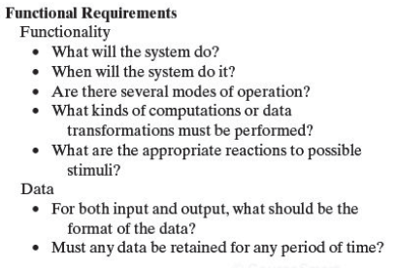
Functional Requirements

Slide 7
Example
User story: As an existing user, I want to be able to log into my account.
Functional requirement:
Log In
The system must allow users to log into their account by entering their email and password.
The system must allow users to log in with their Google accounts.
The system must allow users to reset their password by clicking on "I forgot my password" and receiving a link to their verified email address.

Slide 8
Non-functional Requirements
Non-functional or Quality requirements, as the name suggests, are requirements that are not directly concerned with the specific services delivered by the system to its users.
These non-functional requirements usually specify or constrain characteristics of the system as a whole.
A nonfunctional requirement (NFR) can be described as a quality attribute, a performance attribute, a security attribute, or a general constraint on a system.

Slide 9
Example
Security
Users shall be forced to change their password the next time they log in if they have not changed it within the length of time established as “password expiration duration”.
Passwords shall never be visible at the point of entry or at any other time.
Any new login shall be allowed after two step verification.

Slide 10
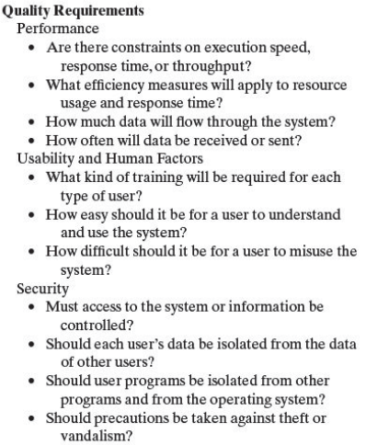
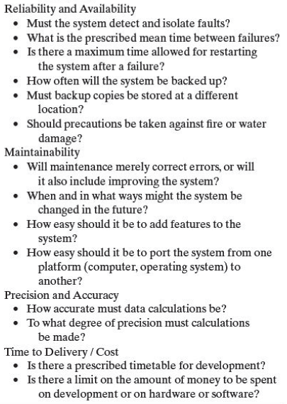
Non-functional Requirements

Slide 11
Testable Requirements
Testable/Measurable Requirement:
A requirement which is unambiguous and clearly specifies the behaviour.
Objective description of the requirement’s meanings.
All possible entities and activities can be examined and classified as Meet Requirements and Do Not Meet Requirements.
Testable requirements are helpful in making good design.
Requirements that are not testable are likely to be ambiguous, incomplete and incorrect.

Slide 12
Testable Requirements
3 ways to help make requirements testable:
Specify a quantitative description for each adverb and adjective
Replace pronouns with specific names of entities
Make sure that every noun is defined in exactly one place in the requirements document

Slide 13
Testable/Non-Testable Requirements
Some examples:
Not Testable: Water quality information must be accessible immediately
Testable: Water quality information must be retrieved within five seconds of request
Not Testable: The system should handle a large number of users at a time
Testable: The system should handle 5000 users at a time
Not Testable: User should press the Save button when writing text in the system. This prevents it from being lost.
Testable: User should press the Save button when writing a note in the system. Pressing the Save button prevents the text from being lost.

Slide 14
Requirements Documentation
No matter what method we choose for defining requirements, we must keep a set of documents recording the result.
We and our customers will refer to these documents throughout development and maintenance.
Clear and precise illustrations and diagrams accompanying the documentation should be consistent with the text.

Slide 15
Requirements Definition
The requirements definition is a record of the requirements expressed in the customer’s terms. Working with the customer, we document what the customer can expect of the delivered system:
Outline the general purpose and scope of the system, including relevant benefits, objectives, and goals
Describe the background and the rationale behind proposal for new system
Describe the essential characteristics of an acceptable solution
Describe the environment in which the system will operate
Outline a description of the proposal, if the customer has a proposal for solving the problem
List any assumptions we make about how the environment behaves

Slide 16
Requirements Specification
The requirements specification covers exactly the same ground as the requirements definition, but from the perspective of the developers.
Where the requirements definition is written in terms of the customer’s vocabulary, referring to objects, states, events, and activities in the customer’s world, the requirements specification is written in terms of the system’s interface.
We accomplish this by rewriting the requirements so that they refer only to those real-world objects (states, events, actions) that are sensed or actuated by the proposed system.

Slide 17
Requirements Specification
Describe all inputs and outputs in detail, including
the sources of inputs
the destinations of outputs
the value ranges
data format of inputs and output data
data protocols
window formats and organizations
timing constraint
Restate the required functionality in terms of the interfaces' inputs and outputs
Devise fit criteria for each of the customer's quality requirements

Slide 18
IEEE Standard for SRS Document
Introduction to the Document
1.1 Purpose of the Product
1.2 Scope of the Product
1.3 Acronyms, Abbreviations, Definitions
1.4 References
1.5 Outline of the rest of the SRS
General Description of Product
2.1 Context of Product
2.2 Product Functions
2.3 User Characteristics
2.4 Constraints
2.5 Assumptions and Dependencies
Specific Requirements
3.1 External Interface Requirements
3.1.1 User Interfaces
3.1.2 Hardware Interfaces
3.1.3 Software Interfaces
3.1.4 Communications Interfaces
3.2 Functional Requirements
3.2.1 Requirement 1
3.2.2 Requirement 2
…
3.3 Performance Requirements
3.4 Design Constraints
3.5 Other Quality Requirements
3.6 Other Requirements
Appendices

Slide 19
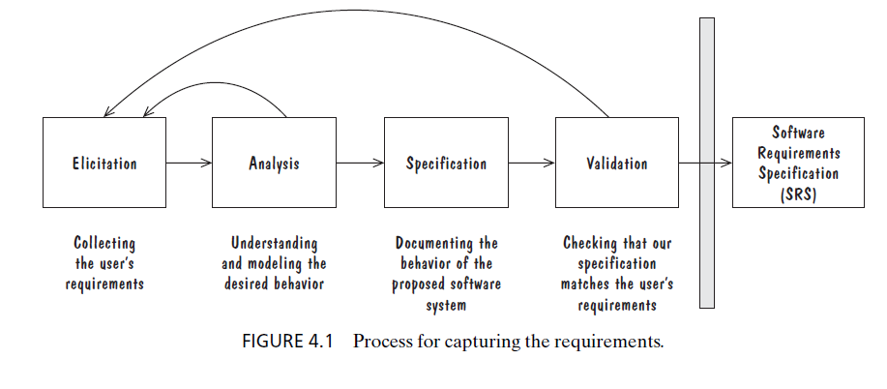
Capturing Requirements

Slide 20
Process Management and Requirements Traceability
Process management is a set of procedures that track
the requirements that define what the system should do
the design modules that are generated from the requirement
the program code that implements the design
the tests that verify the functionality of the system
the documents that describe the system
It provides the threads that tie the system parts together

Slide 21
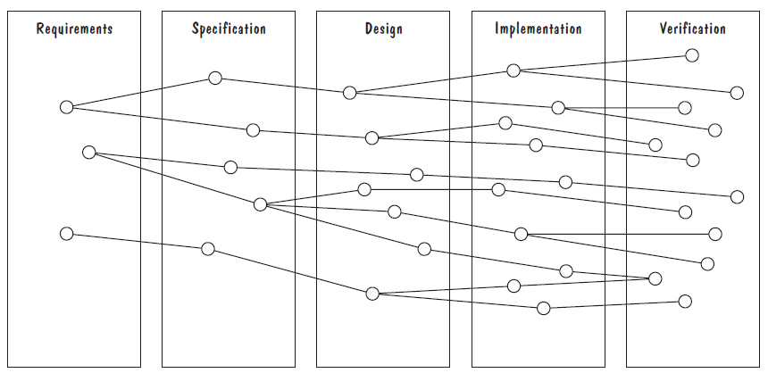
Process Management and Requirements Traceability
Horizontal threads show the coordination between development activities

Slide 22
Validation and Verification
In Requirements Validation, we check that our requirements definition accurately reflects the customer’s—actually, all of the stakeholders’—needs.
In Verification, we check that one document or artifact conforms to another. Thus, we verify that our code conforms to our design, and that our design conforms to our requirements specification; at the requirements level, we verify that our requirements specification conforms to the requirements definition.
To summarize, verification ensures that we build the system right, whereas validation ensures that we build the right system!

Slide 23
Requirements Review
Review the stated goals and objectives of the system
Compare the requirements with the goals and objectives
Review the environment in which the system is to operate
Review the information flow and proposed functions
Assess and document the risk, discuss and compare alternatives
Testing the system: how the requirements will be revalidated as the requirements grow and change

Slide 24
Measuring Requirements
Measurements focus on three areas
product
process
resources
Number of requirements can give us a sense of the size of the developed system
Number of changes to requirements
Many changes indicate some instability or uncertainty in our understanding of the system
Requirement-size and change measurements should be recorded by requirements type

Slide 25
Measuring Requirements
Rating Scheme on Scale from 1 to 5
You understand this requirement completely, have designed systems from similar requirements, and have no trouble developing a design from this requirement
Some elements of this requirement are new, but they are not radically different from requirements that have been successfully designed in the past
Some elements of this requirement are very different from requirements in the past, but you understand the requirement and can develop a good design from it
You cannot understand some parts of this requirement, and are not sure that you can develop a good design
You do not understand this requirement at all, and can not develop a design

Slide 26
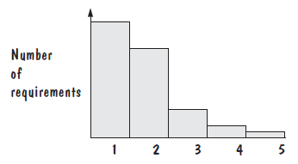
Measuring Requirements
If the designers and testers yield profiles with mostly 1s and 2s, as shown in Figure, then the requirements are in good shape and can be passed on to the design team.

Slide 27
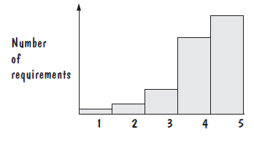
Measuring Requirements
If there are many 4s and 5s, then the requirements should be revised, and the revisions reassessed to have better profiles, before we proceed to design.

Slide 28
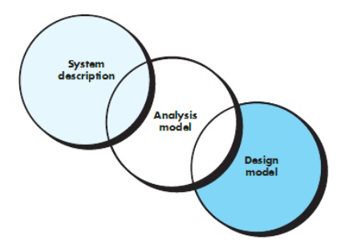
Analysis
Focus on requirements
Each element should improve understanding of requirements
Delay consideration of infrastructure till design
Requirements model provides value to all stakeholders
Keep the models simple

Slide 29
References
Roger S. Pressman, Software Engineering A Practitioner’s Approach, 9th Edition. McGrawHill
Shari PFleeger, Joanne Atlee, Software Engineering: Theory and Practice, 4th Edition
Roger S. Pressman, Software Engineering A Practitioner’s Approach, 5th Edition. McGrawHill

